Slide 1

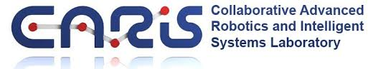



SCIT/SIT Video data analysis
Step 3: Algorithm Analysis
Yanyun Bu
Undergraduate Academic Assistant
H-Behaviours Research Lab
BC Children’s Hospital Research Institute
Supervisor: Dr. Osman Ipsiroglu
Dr. Mike Van der Loos

Slide 2
1. The methods to detect movement
Velocity
Velocity (five-point stencil)
Magnitude

Slide 3
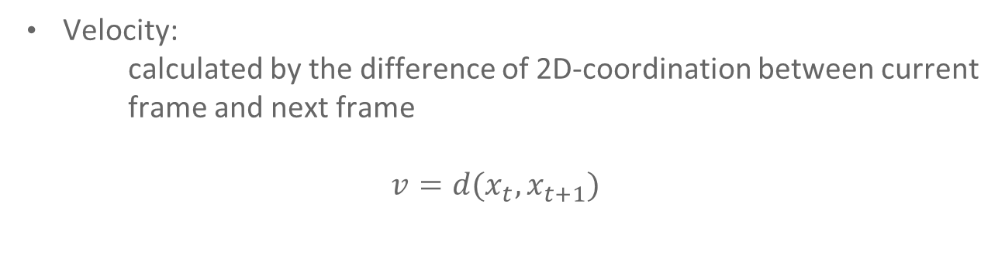
1. The methods to detect movement
Velocity:
calculated by the difference of 2D-coordination between current frame and next frame
$$v=d(x_{t},x_{t+1})$$

Slide 4
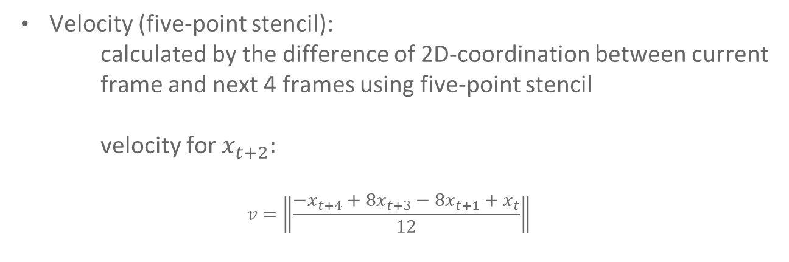
1. The methods to detect movement
Velocity (five-point stencil):
calculated by the difference of 2D-coordination between current frame and next 4 frames using five-point stencil
velocity for $x_{t+2}:$
$$v=\left\|\frac{−x_{t+4}+8x_{t+3}−8x_{t+1}+x_{t}}{12}\right\|$$

Slide 5
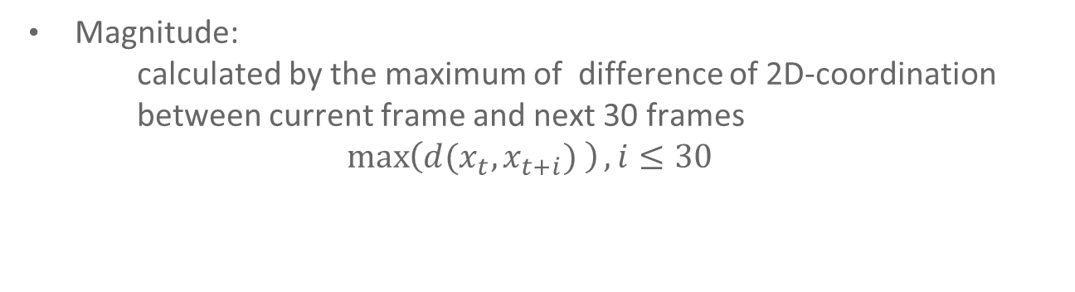
1. The methods to detect movement
Magnitude:
calculated by the maximum of difference of 2D-coordination between current frame and next 30 frames
$$\max\left(d(x_{t},x_{t+i}) \right), i≤30$$

Slide 6
2. Detecting movement
Define a number for the velocity of movement as a threshold to detect movement
ex. Threshold = 6 pixels / sec

Slide 7
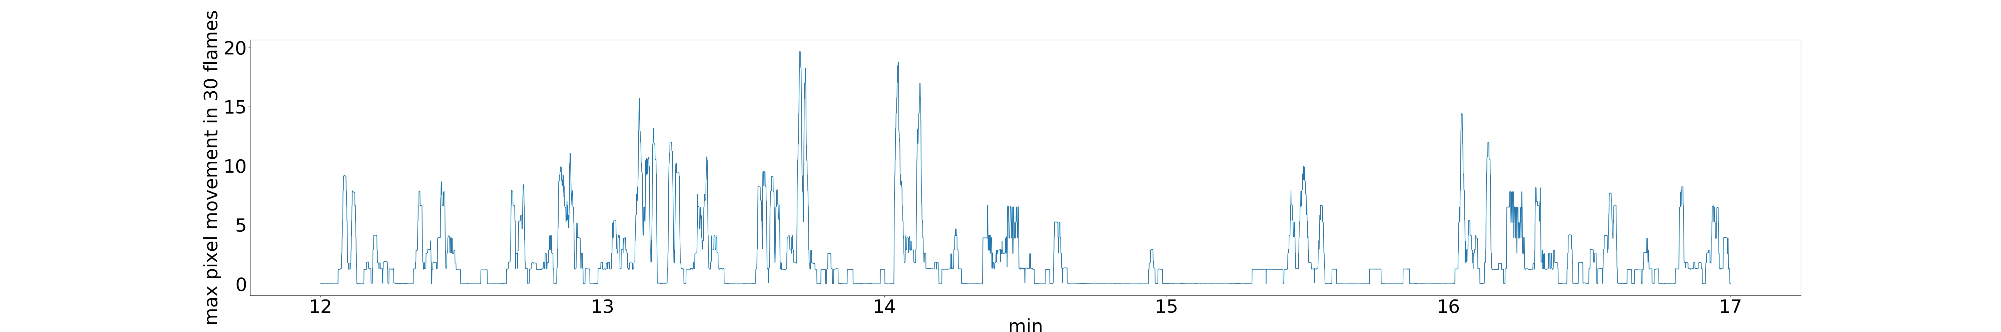
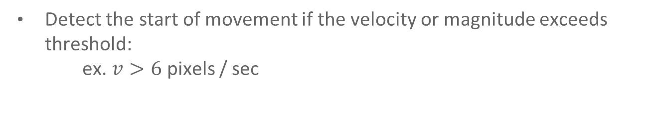
2. Detecting movement
Detect the start of movement if the velocity or magnitude exceeds threshold:
ex. $v>6$ pixels / sec

Slide 8
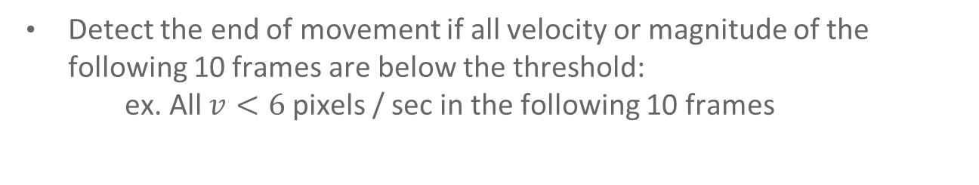
2. Detecting movement
Detect the end of movement if all velocity or magnitude of the following 10 frames are below the threshold:
ex. All $v<6$ pixels / sec in the following 10 frames

Slide 9
3. Algorithm analysis
Focus on nose detection (hardest part)
Use different level of threshold on these 3 method to count the true positives, false positives, and false negatives
Calculate precision(positive predictive value) and recall(sensitivity) for each methods

Slide 10
4. Data
6 research assistants’ annotation
5 participants
10 min SCIT video

Slide 11
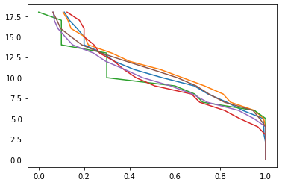
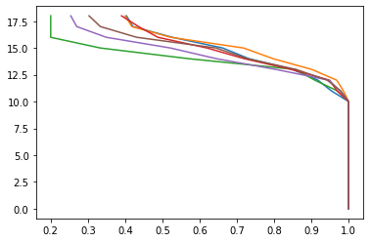
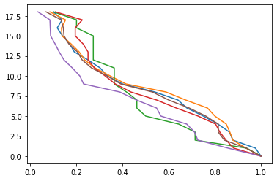
5. Result
Recall rate of each method with different threshold on nose:
X: recall rate
Y: degree of threshold
Left to right: velocity, velocity(five-point stencil), and magnitude

Slide 12
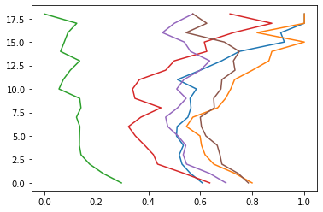
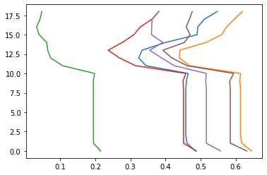
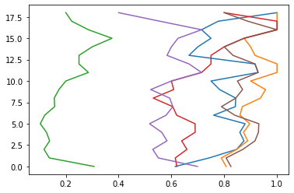
5. Result
Precision rate of each method with different threshold on nose:
X: precision rate
Y: degree of threshold
Left to right: velocity, velocity(five-point stencil), and magnitude

Slide 13
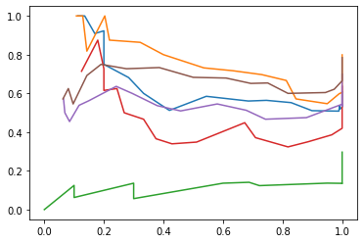
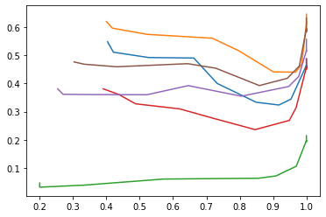
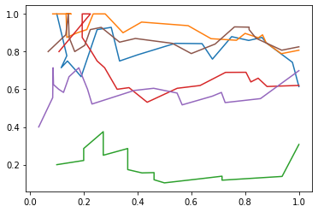
5. Result
ROC curve of each method with different threshold on nose:
X: recall rate
Y: precision rate
Left to right: velocity, velocity(five-point stencil), and magnitude
AUC: 0.469, 0.233, 0.611

Slide 14
4. Problem
The variance between researcher annotations is too high.
The noisy of 2 velocity methods is high. It may causes they are not able to detect small movement.
If we need more specific analysis on method, we can let clinicians and experts to view the output of methods or we can create a new standard researcher annotation.

Slide 15
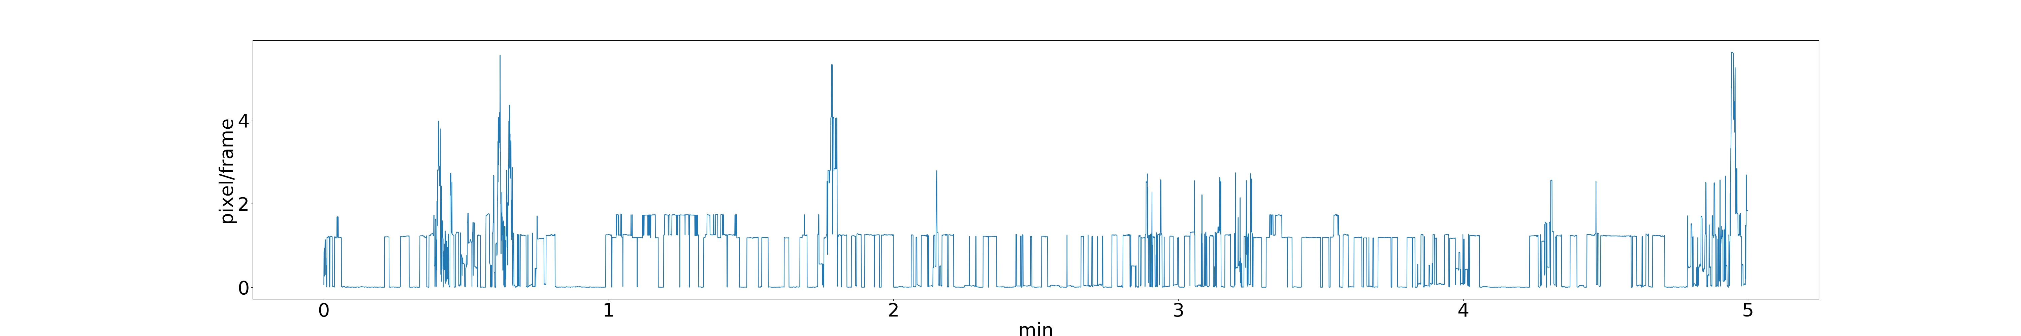
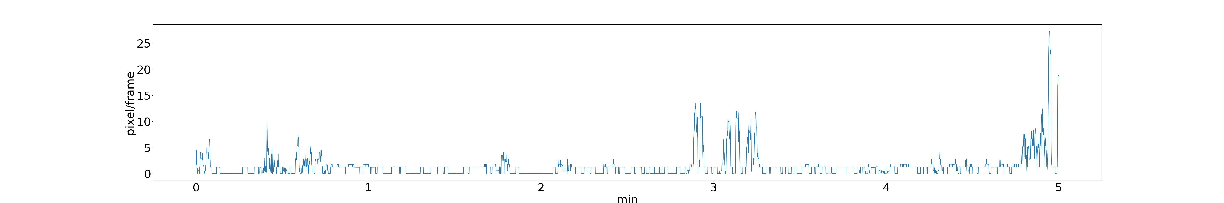
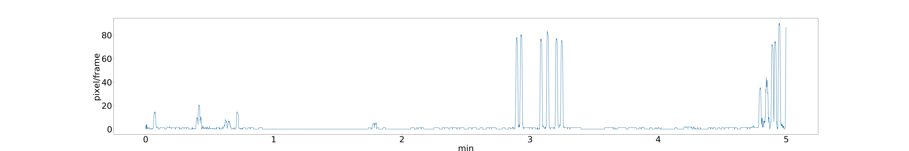
5. Some interesting findings
Shoulder, elbow, and wrist in left arm

Slide 16
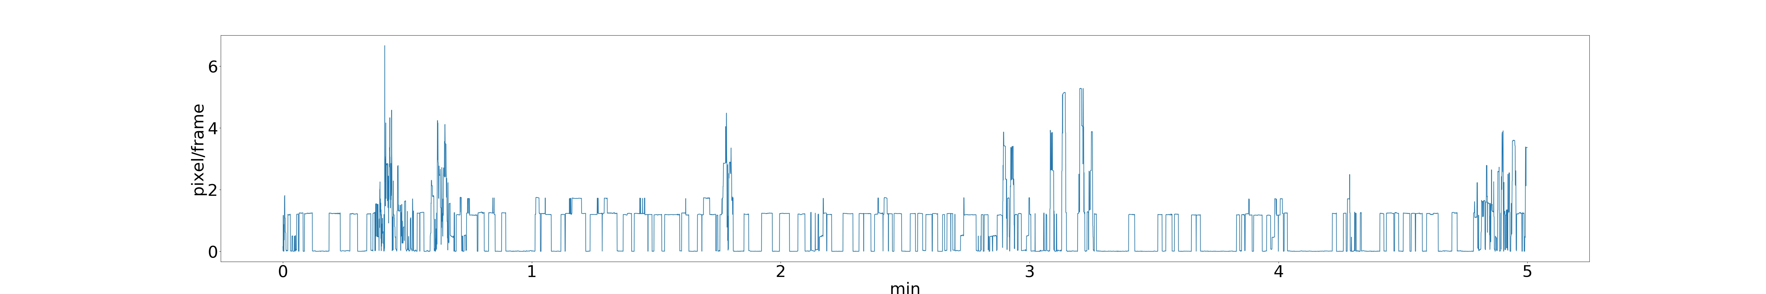
5. Some interesting findings
Right shoulder and left shoulder

Slide 17
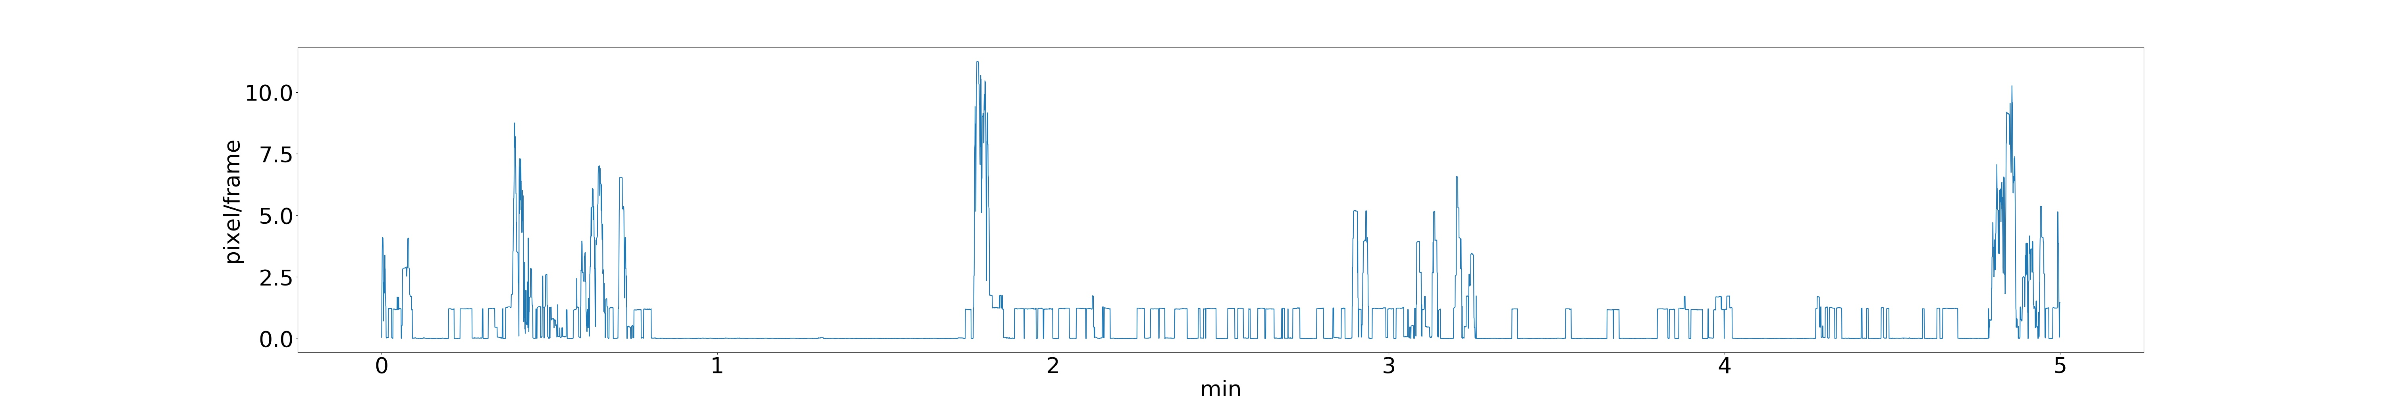
5. Some interesting findings
Right elbow and left elbow

Slide 18
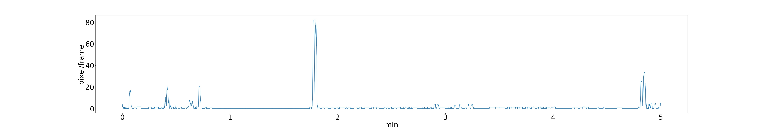
5. Some interesting findings
Right wrist and left wrist

Slide 19
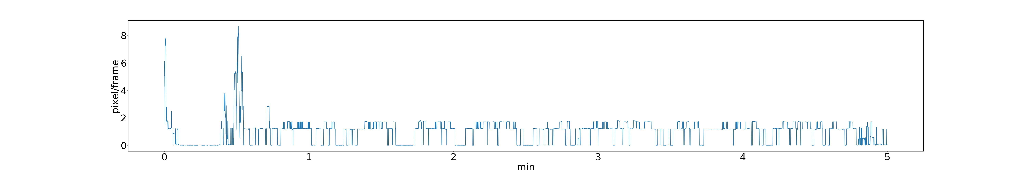
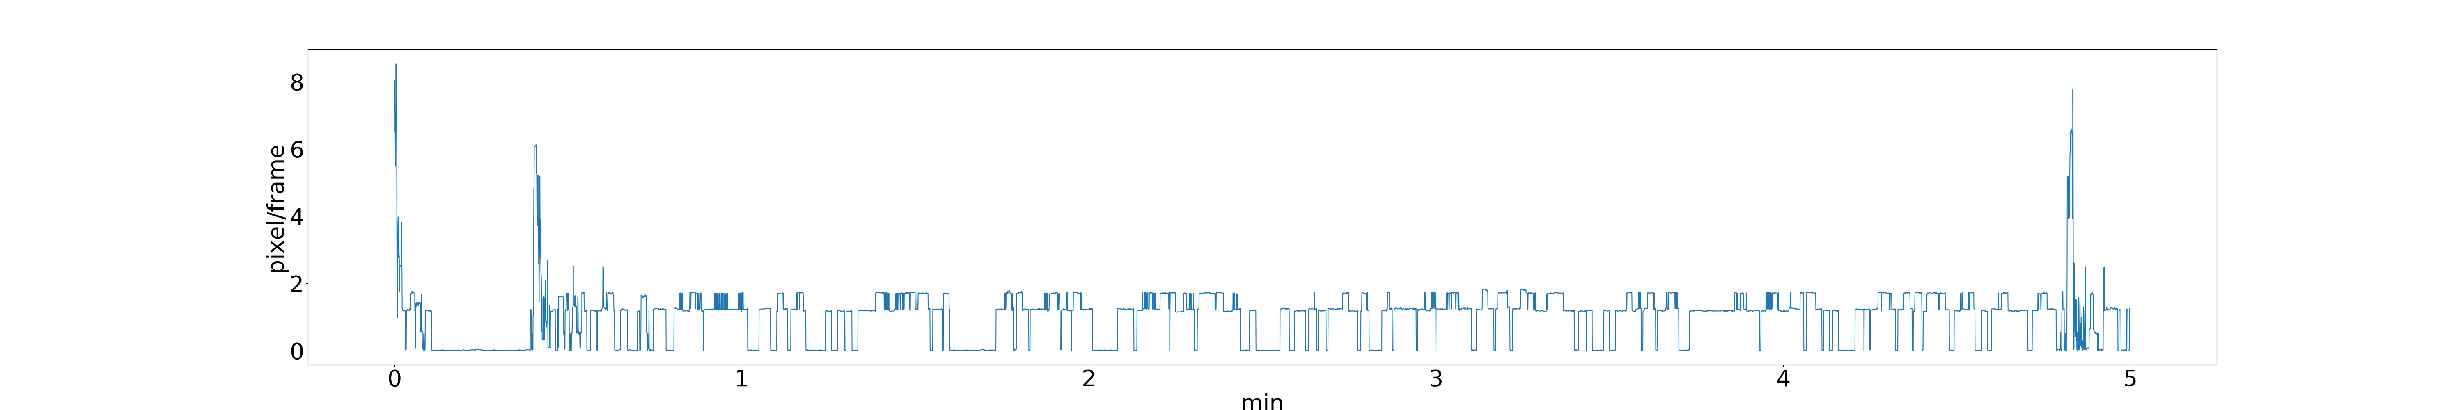
5. Some interesting findings
Right knee and left knee

Slide 20
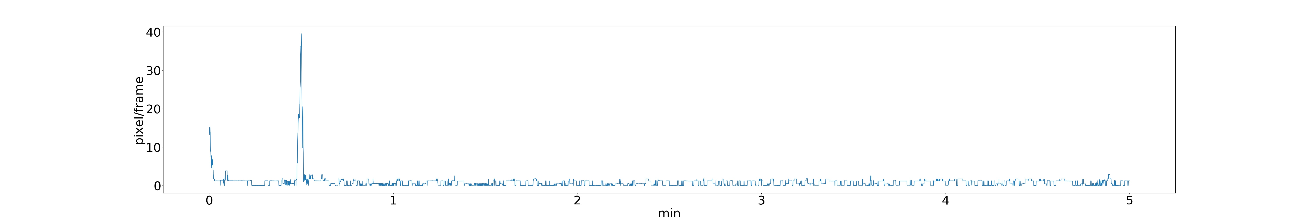
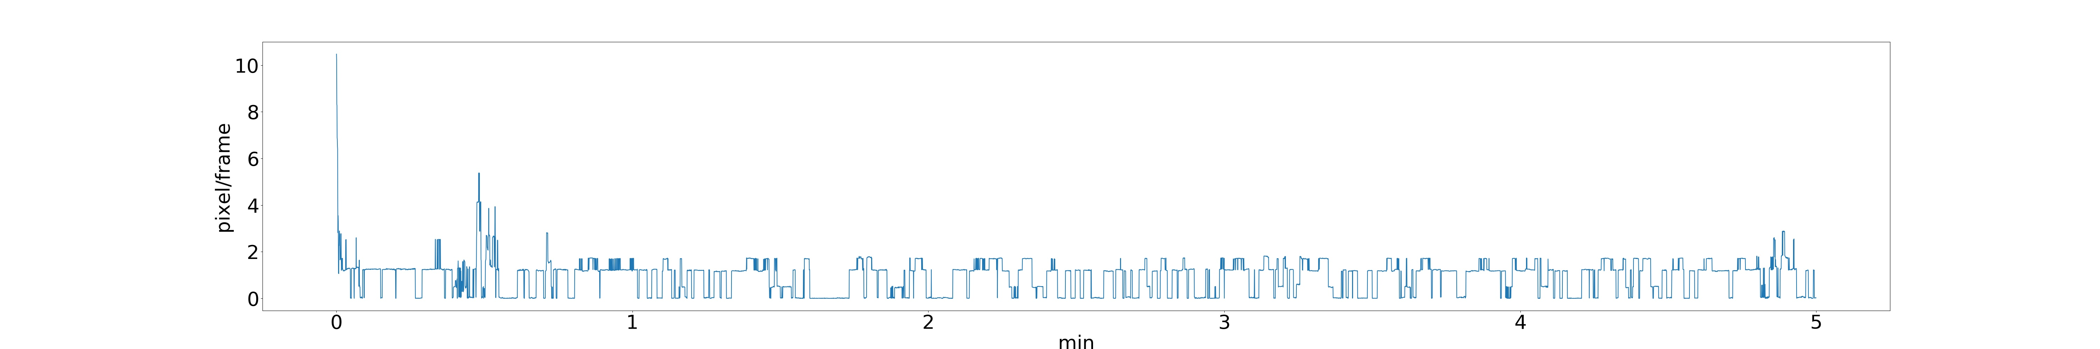
5. Some interesting findings
Right ankle and left ankle

Slide 21
5. Some interesting findings
Right elbow and right knee

Slide 22
5. Some interesting findings
Right wrist and right ankle

